Slide 1

Who Does What, By When?
Getting Started with AP®: The Basics
Summer 2022

Slide 2

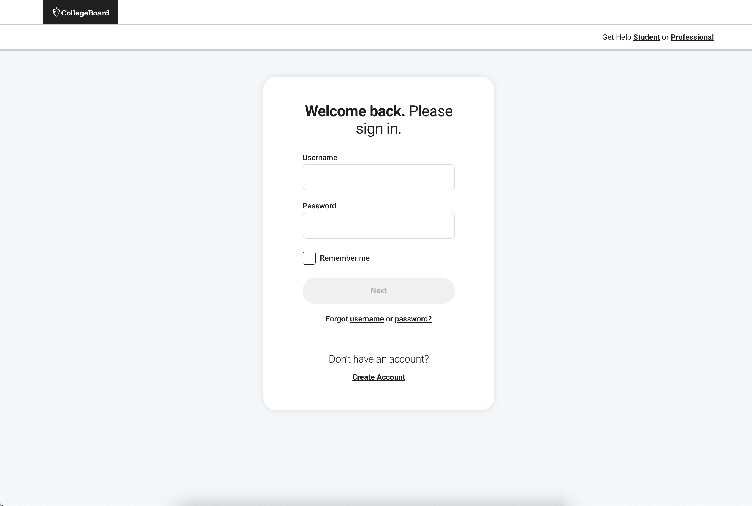
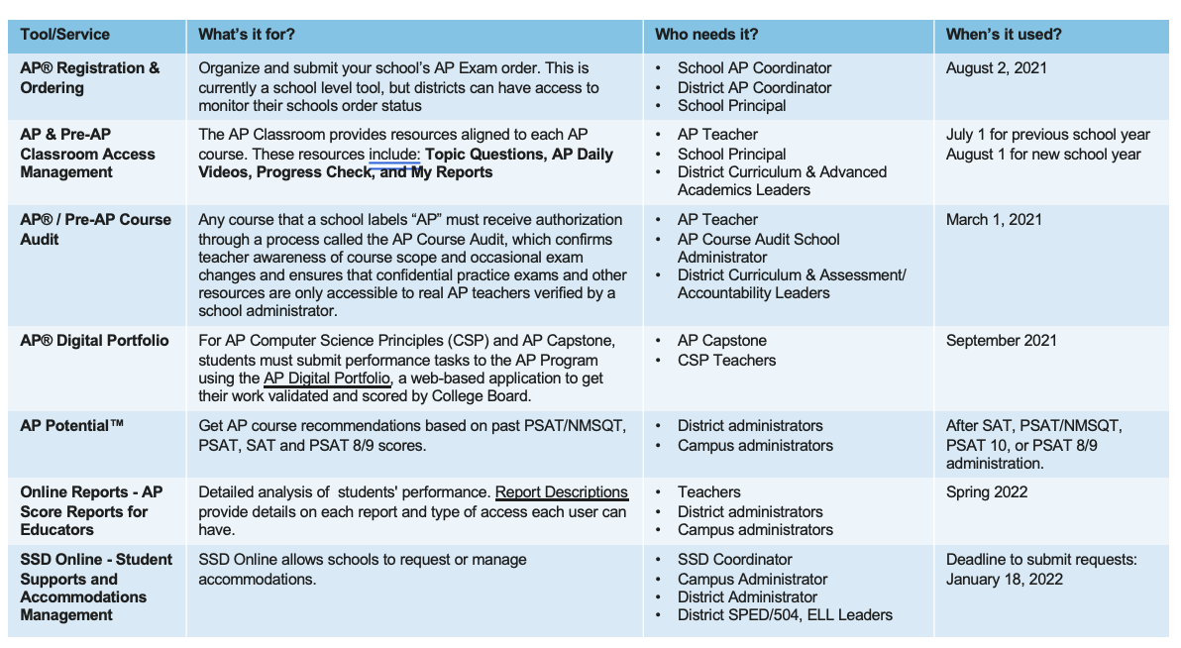
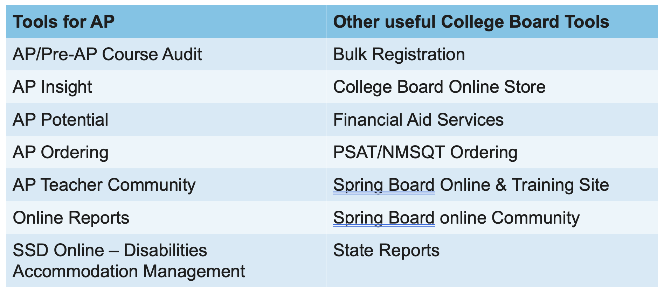
Getting Started
College Board
Professional Account
Role
Matrix
Tool
Access
You’ll learn what a College Board professional account is, why
you need one, and how to get one.
You’ll learn what the roles are when working with AP® and who in
your district might need that role.
You’ll learn about the tools you’ll need to get the most out of your
AP account.

Slide 3
Your College Board Professional Account
Why do I need one?
A College Board professional account is free and establishes you as an educational professional with College Board.
You have access to tools and services designed specifically for education professionals.
Tools for AP | Other Useful College Board Tools
AP/Pre-AP® Course Audit | Bulk Registration
AP Insight | College Board Online Store
AP PotentialTM | Financial Aid Services
AP Registration & Ordering | PSAT/NMSQT® Ordering
AP Teacher Community | SpringBoard® Online and Training Site
Online Reports | SpringBoard Online Community
SSD Online – Disabilities Accommodations Management | State Reports

Slide 4
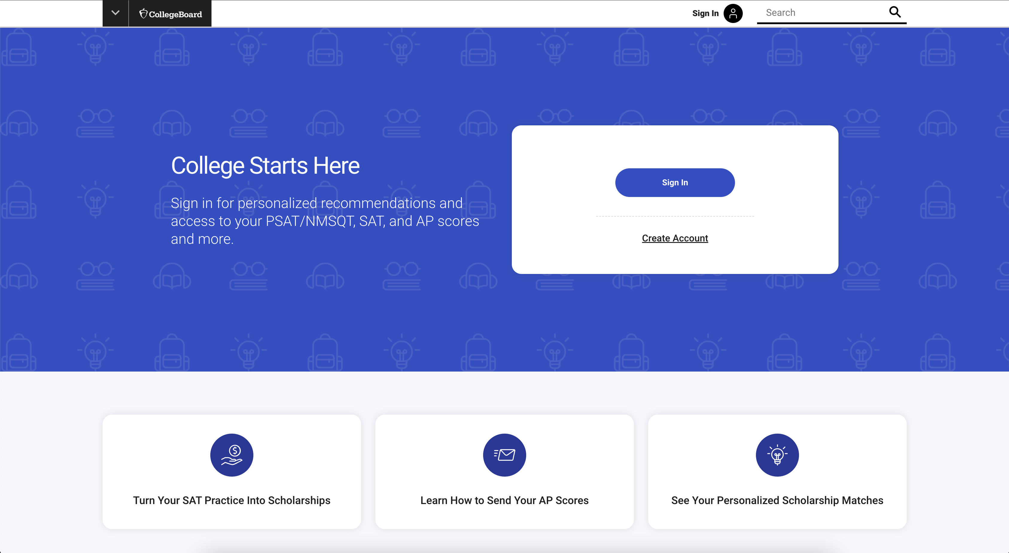
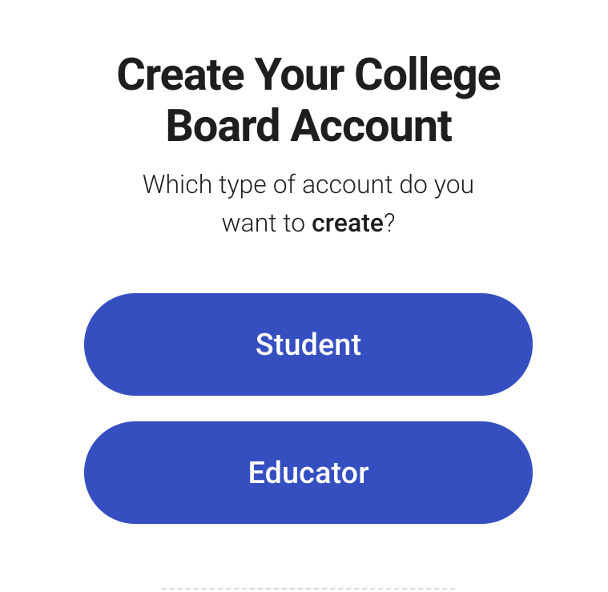
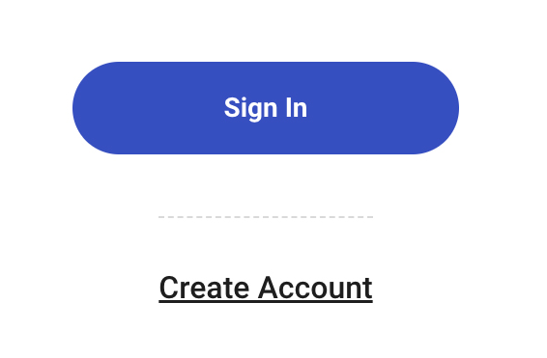
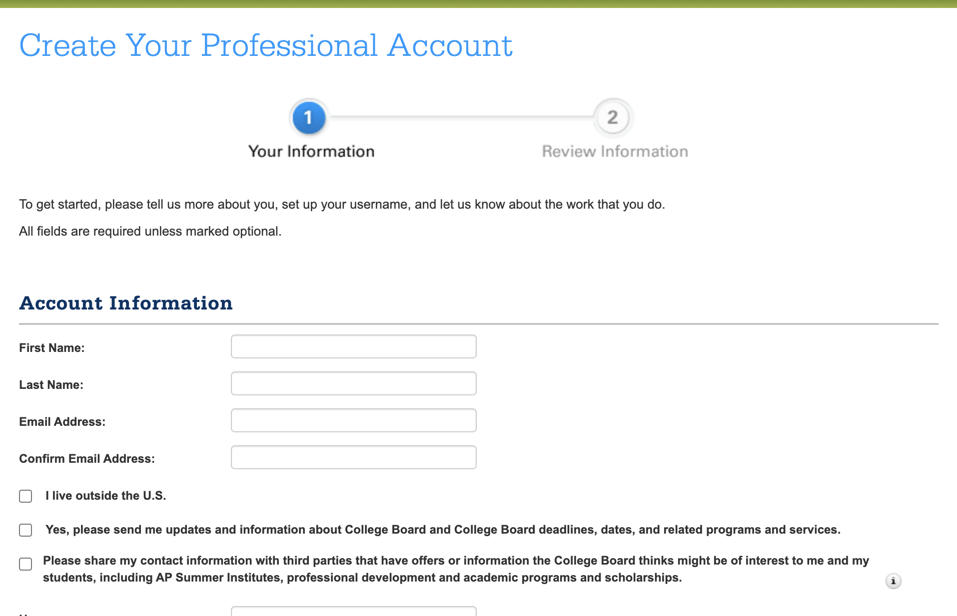
Q: How do I create a professional account?
Visit the Web
Sign Up
Select Your Role
Enter Your Info
Go to
collegeboard.org
Click Create Account
It’s located under the Sign In button
Select Educator
Enter your information
Select your professional organization from the list of options.
Click Review, then Save your profile.
This is a bullet.
This is another bullet.

Slide 5
Working with Access Codes and Tools
I have my professional account. Now what?
Now that you’ve created your professional account, it’s time to decide what tools and services you’ll need access to.
This Role Matrix is designed to help you decide.
Tool/Service | What’s it for? | Who needs it? | When’s it used?
AP® Registration & Ordering | Organize and submit your school’s AP Exam order. This is currently a school-level tool, but districts can have access to monitor their schools order status | School AP coordinator District AP coordinator School principal | August 2, 2021
AP & Pre-AP® Classroom Access Management | The AP Classroom provides resources aligned to each AP course. These resources include: Topic Questions, AP Daily Videos, Progress Check, and My Reports | AP teacher School principal District curriculum & advanced academics leaders | July 1 for previous school year August 1 for new school year
AP/Pre-AP Course Audit | Any course that a school labels “AP” must receive authorization through a process called the AP Course Audit, which confirms teacher awareness of course scope and occasional exam changes and ensures that confidential practice exams and other resources are only accessible to real AP teachers verified by a school administrator. | AP teacher AP Course Audit school administrator District curriculum & assessment/ accountability leaders | March 1, 2021
AP Digital Portfolio | For AP Computer Science Principles (CSP) and AP CapstoneTM, students must submit performance tasks to the AP Program using the AP Digital Portfolio, a web-based application to get their work validated and scored by College Board. | AP Capstone CSP teachers | September 2021
AP PotentialTM | Get AP course recommendations based on past SAT® PSAT/NMSQT®, PSATTM 10, and PSATTM 8/9 scores. | District administrators Campus administrators | After SAT, PSAT/NMSQT, PSAT 10, or PSAT 8/9 administration.
Online Reports - AP Score Reports for Educators | Detailed analysis of students' performance. Report Descriptions provide details on each report and type of access each user can have. | Teachers District administrators Campus administrators | Spring 2022
SSD Online - Student Supports and Accommodations Management | SSD Online allows schools to request or manage accommodations. | SSD coordinator Campus administrator District administrator District SPED/504, ELL leaders | Deadline to submit requests: January 18, 2022

Slide 6
Q: How do I access the tools?
I have an account and know what the tools do.
There are a couple ways to add access.
  If you don’t yet have an account, and you choose to create one directly from a prompt in the tool or service you want to use, it works like this:
  During the sign-up process, you’ll be automatically guided to a page where you can enter your access code for that service (if required)
You can then proceed to either use the service immediately or go to your account homepage.
  If you already have an account, and you’re adding access to a tool or service, it works like this:
  Sign in and go to My College Board Professional Account
  In the “Add Additional Tools and Services” section, find the item you want access to and select “Get access” (or “Request access,” depending on which it is)
  From there, you’ll be guided through the process of getting access

Slide 7
Q: How do I get an access code?
I have an account and know what the tools do.
It depends on the tool you want to access. This table explains who to contact and when codes expire.
Tool/Service | How do I get an access code? | When does it expire? | Contact?
AP Registration & Ordering and AP & Pre-AP Classroom Access Management | Codes are sent each year on Aug. 1 to the school’s AP coordinator. | Yearly | AP Services for Educators Call Center Hours: M–F, 9 a.m.–6 p.m. ET Phone: 877-274-6474 (toll free in the United States and Canada) 212-632-1781 (International) 610-290-8979 (fax) Contact Form: cb.org/apeducatorinquiry
AP/Pre-AP Course Audit | To get an access code contact the AP Course Audit Helpline. | If you have accessed your AP Course Audit account within the past 2 years, your access code will not expire. | The AP Course Audit Helpline Monday—Friday, 8 a.m.–5 p.m. Phone: Toll free at 1-877-APHELP-0 (274-3570); International users call 541-246-2500.
Continued on next slide

Slide 8
Tool/Service | How do I get an access code? | When does it expire? | Contact?
AP Digital Portfolio | Contact AP Services for Educators | Yearly | AP Services for Educators Call Center Hours: M–F, 9 a.m.–6 p.m. ET Phone: 877-274-6474 (toll free in the United States and Canada) 212-632-1781 (International) 610-290-8979 (fax) Contact Form: cb.org/apeducatorinquiry
AP Potential | District AP Potential access codes are mailed to the attention of district officials in early December. Access codes are emailed in early December to principals and AP coordinators, and also appear on the PSAT/NMSQT Roster of Scores. | AP Potential access codes expire on December 1 each year and new access codes are provided. | College Board Customer Service Call Center Hours: M–F, 8 a.m.–8 p.m. ET Phone: 877-274-6474 (toll-free in the United States and Canada) 212-632-1781 (International) 610-290-8979 (fax)
Continued on next slide

Slide 9
Tool/Service | How do I get an access code? | When does it expire? | Contact?
College Board Online Store | Access codes for APSI products are emailed in April. | APSI access codes expire on September 15th of the current year. | College Board Publications 800-323-7155
Online Reports ‑ AP Score Reports for Educators | AP Online Reports access codes are emailed to the AP coordinator, the alternate AP coordinator, and the principal as listed on the AP participation form, as well as the people at your institution who have active AP Course Audit authorization access. | Access codes expire each year on June 23. However, each year we attempt to identify as many users as we can to renew access automatically. Candidates for automatic renewal are those users who have active AP Ordering access, AP Course Audit access, or are listed as a contact on the AP participation form. | AP Services for Educators Call Center Hours: M–F, 9 a.m.–6 p.m. ET Phone: 1-877-274-6474 (toll-free in the United States and Canada) or 212-632-1781 (International) Contact Form: cb.org/apeducatorinquiry
SSD Online - Student Supports and Accommodations Management | SSD Online access can be requested by filling out an SSD Coordinator Form. As soon as the form is processed (usually within 2-3 business days), you will be sent access codes, via email, that will allow you to access the application. | Yearly | Services for Students with Disabilities (SSD) Email: ssd@info.collegeboard.org Phone: 844-255-7728 International: +1-212-713-8333

Slide 10
Thank You!

