Slide 1

Discover How AP Supports Readiness Goals for All Students
®
About AP for District Administrators
Summer 2022

Slide 2
Contents
01
What Is AP?
02
Why Offer AP? Discover the Benefits
03
AP and CTE: Working Together
for All Students
04
AP By the Numbers

Slide 3
What Is AP?
An Overview for District Leaders

Slide 4


What Is AP?
An overview
The Advanced Placement® Program (AP®) enables willing and academically prepared students to pursue college-level studies while still in high school.
The program consists of college-level courses developed
by the AP Program that high schools can choose to offer
and corresponding exams that are administered once a year.
See how your school can offer AP courses.
There are 38 AP courses in seven subject categories.
Each AP course is modeled on a comparable introductory college course in the subject. Learn how AP courses are developed.

Slide 5
Taking AP Courses and Exams Can Help Students
Stand out on college applications.
AP courses on a student’s transcript shows that they’ve challenged themselves with the most rigorous courses available to them. And success on an AP Exam shows that they’re ready for college-level coursework.
Earn college credit and/or skip
introductory courses in college.
Most four-year colleges and universities in the United States—as well as many institutions in more than 100 other countries—grant students' credit, placement, or both for qualifying AP Exam scores.
Search credit policies by college.

Slide 6
Why Offer AP?
Discover the Benefits
What can AP do for my students?

Slide 7
Why Schools Embrace AP
It’s recognized globally.
It’s empowering.
It’s rigorous.
It’s accessible.
It’s effective.
It’s innovative.
It’s adaptable.

Slide 8
More Than a Score
Students Benefit No Matter Their Score
Build skills and confidence.
AP students learn essential time management and study skills needed for college and career success.
They dig deeper into subjects that interest them and learn to tap their creativity and their problem-solving skills to address course challenges.
Get into college.
Students who take AP courses send a signal to colleges that they’re serious about their education and that they’re willing to challenge themselves with rigorous coursework.^{[1]}
85% of selective colleges and universities report that a student’s AP experience favorably impacts admission decisions.^{[2]}

Slide 9
AP and CTE: Working Together for All Students
It’s Innovative

Slide 10

All Students Can Be AP Students
The Advanced Placement (AP) Program prepares students for success not only in college and career but, more importantly, in life. And when students participate in career and technical education (CTE) in addition to AP, they’re setting themselves up for a successful future.
AP courses lend themselves to project based and competency-based learning. AP teachers using a project based learning (PBL) approach can develop students' deep learning of knowledge and skills while preparing them for their AP Exams.
  Research shows teachers who engage in Knowledge in Action (KIA) project based curricula for AP courses have better outcomes for all student groups on the AP Exam.

Slide 11
AP and CTE Courses Can and Should Work in Tandem
AP and CTE support career readiness by encouraging the development of the academic knowledge and technical skills that are, together, increasingly important to students’ overall employability.
AP and CTE courses complement and supplement one another by letting students focus their high school coursework and training on career areas they aspire to work in.
For too long, “college-ready” and “career-ready” coursework and experiences have been separate in our schools; the alignment of AP and CTE courses shows this divide only limits learners’ options.
At the same time, CTE students are increasingly pursuing postsecondary education and are just as likely to enroll in college as their non-CTE peers.

Slide 12


Why AP and CTE Matter
Georgetown’s Center on Education and the Workforce projects that by 2020:
Through 2020, there will be:
of all jobs in the economy will require postsecondary education and training beyond high school
24 million from newly created jobs
31 million due to baby boomer retirements

Slide 13
Career Alignment
College Board teamed up with Advance CTE and CTE directors from multiple states to consider how AP courses connect to the 16 Career Clusters listed in the National Career Clusters® Framework. Check out our career cluster alignment.
“It is a false premise to suggest you’re either an academic or career technical student. That is why we embed Advanced Placement courses into our career pathways. Students need to develop strong academic foundations regardless of their career pathway, so we cannot educate them in silos.”
—Dr. Lazaro Lopez,
Associate Superintendent for Teaching and Learning, High School District 214, Arlington Heights, Illinois

Slide 14
AP By the Numbers
AP for All Students

Slide 15
AP By the Numbers
Succeed in College and Career pathways
You may already know:
Research shows that students who receive a score
of 2 on their AP Exams are ready for college work.^{[3]}
Research shows that students who receive a score
of 3 or higher on AP Exams typically experience greater academic success in college and have higher graduation rates than their non-AP peers.^{[4]}
3 out of 4 AP students enrolled in a four-year college start school with some AP credit.^{[5]}
But did you know:
AP students who earn a score of 1 or 2—or average a score of 1 or 2 across their AP Exams in high school—have better college outcomes than academically similar college students who did not take an AP course and exam.

Slide 16
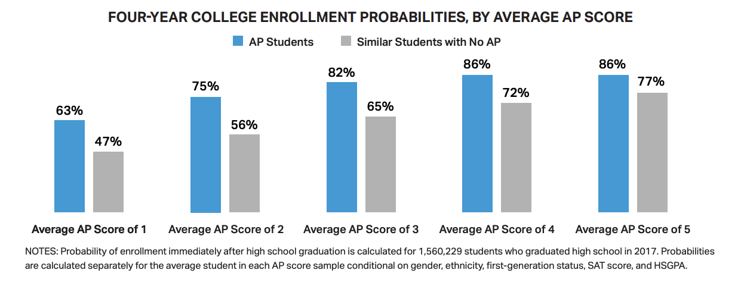
Finding #1: College Enrollment
AP students, including those with average scores of 1 or 2, are more likely to enroll in a four-year college compared to academically similar students who did not take AP in high school.

Slide 17
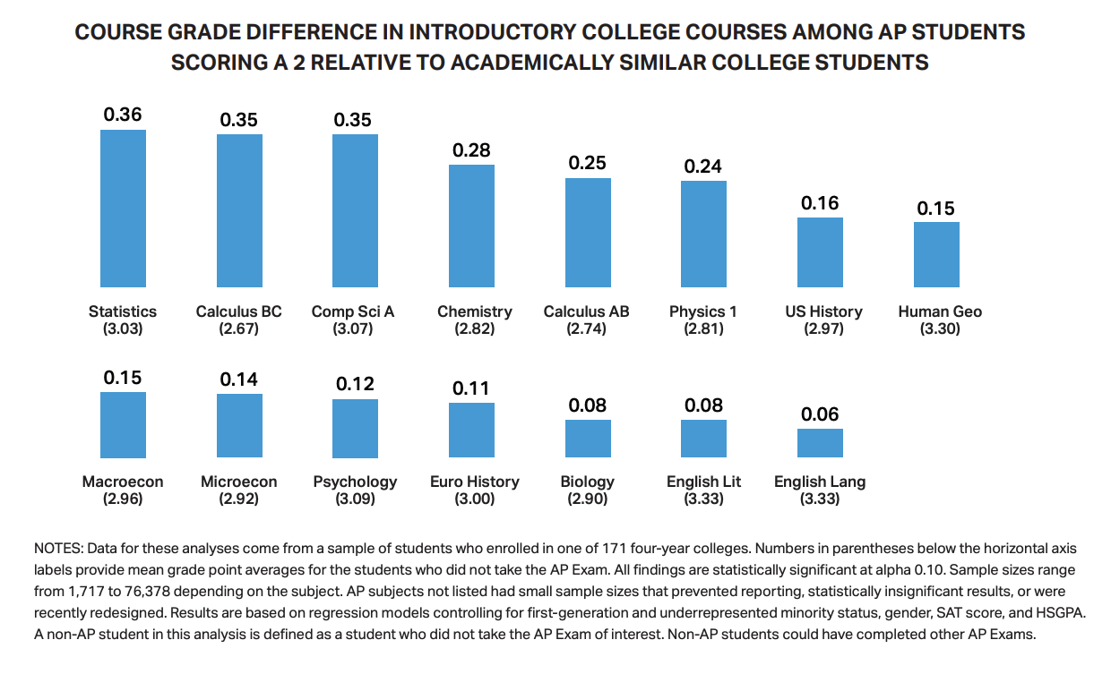
Finding #2: College Readiness
Students who earn AP scores of
2 are well prepared to succeed in introductory college coursework.
Compared to academically similar college peers who did not take the AP course, AP students who earn scores of 2 perform as well or better if they take those introductory college courses.

Slide 18
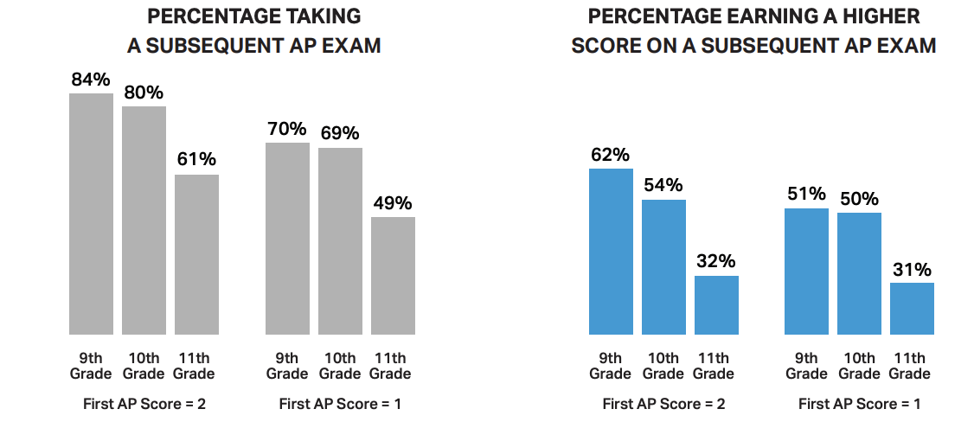
Finding #3: Pathways and Progress
Many students who first score a 1 or 2 on an AP Exam will take further AP courses and score higher. This trend is particularly true for 9th- and 10th-grade students who earn a score of 2 on their first AP Exam.
Depending on when students take their first AP Exam, 61%–84% of students who earn a 2 on their first AP Exam will take another AP Exam in subsequent years.
Students who earn a 1 on their first AP Exam are also very likely (49%–70%) to take more AP courses and exams in high school.

Slide 19
Curious About Your Districts Data?
Let us walk with you!
Reach out to your account manager to set up a data dive.
  Where were you and where are you going?
  Does your data support your goals and targets?
  How can we support you in meeting those goals and targets?

Slide 20
Curious About Your District's Data?
Contact Us
New England
https://collegeboard.tfaforms.net/21?region=NERO
West
https://collegeboard.tfaforms.net/21?region=WRO
Middle States
https://collegeboard.tfaforms.net/21?region=MSRO
Midwest
https://collegeboard.tfaforms.net/21?region=MRO
Southwest
https://collegeboard.tfaforms.net/21?region=SWRO
South
https://collegeboard.tfaforms.net/21?region=SRO

Slide 21
Thank You

